Slide 1

Conducting Community-Level Surveys of Young Adults:
The Vermont Experience
Bob Flewelling
Pacific Institute for Research and Evaluation

Slide 2
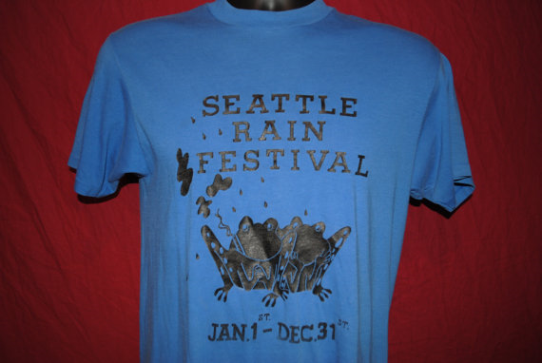

Slide 3
Why focus on young adult surveys?
Highest prevalence rates for most substances
Existing surveys do not provide community-level data
Also:
Young adults are often a mandated target population age group for funded initiatives
Data are needed/required for evaluation

Slide 4
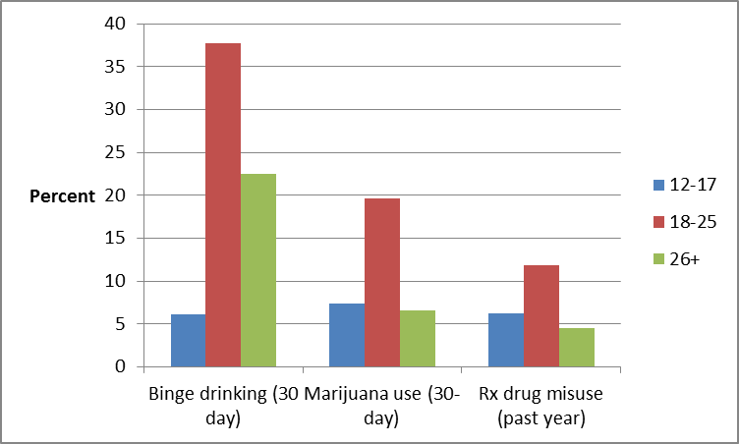
U.S. prevalence rates by age groups
Source: 2014 NSDUH

Slide 5
Obtaining data from young adults at the community-level:
Some considerations
A single statewide survey – state controlled
Locally controlled surveys

Slide 6
Potential advantages of locally controlled surveys
Greater levels of involvement, buy-in and ownership of the data
Facilitates state-community partnership
Communities may make greater use of the data

Slide 7
Potential advantages of state controlled surveys
Standard survey content and methods applied across all communities (and over multiple years)
Allows community organizations to focus on other tasks
Can also be used to develop state-community partnership (over time)

Slide 8
Another methodological consideration…
Paper and pencil
Phone
Other modes
Online

Slide 9
Advantages of online surveys
Easy and inexpensive to distribute
Can potentially reach very large number of respondents
Built–in branching, skip patterns, and consistency checks
Simplifies data management

Slide 10
Recruiting respondents for online surveys
Targeted invitations to individuals
Open invitations (i.e. advertising) to targeted subgroups

Slide 11
What percentage of young adults in the U.S. use Facebook?
62 percent
76 percent
87 percent
Answer: 87 percent

Slide 12

This is how the ad appeared in newsfeed
Notes:
This was our best performing ad

Slide 13






Notes:
Any guesses as to which ad generated the most clicks?

Slide 14
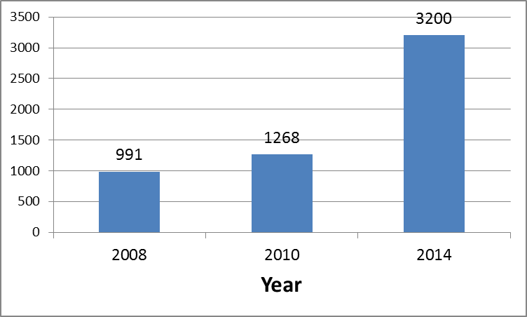
Number of completed surveys each year*
*Advertising costs were $3000-4000 each year

Slide 15
What about response rates?
CSAP encourages grantees to strive for 70% response rate in community-level surveys
But…
Response rate cannot be calculated for surveys using an open invitation to all eligible respondents

Slide 16
Vermont YAS “pseudo” response rate (2014)
N of completed surveys | N of persons “invited” | How determined | Pseudo-response rate
3200 | 72,106 | All age-eligible residents | 4.4%
3200 | 62,732 | All age-eligible residents who use Facebook | 5.1%
3200 | 6,350 | All persons who clicked on the survey link | 50.4%

Slide 17
Can an open invitation online survey attain a 70% response rate?
N of completed surveys | N of persons “invited” | How determined | Pseudo-response rate
3200 | 72,106 | All age-eligible residents | 4.4%
3200 | 62,732 | All age-eligible residents who use Facebook | 5.1%
3200 | 6,350 | All persons who clicked on the survey link | 50.4%

Slide 18
Weighted¹ Prevalence Estimates for Key Outcomes:
YAS Comparisons to VT NSDUH 2012-13
Measure | Young Adult Survey (2014) | NSDUH (2012-13)
Alcohol use in past 30 days | 74.7 | 69.3
Binge drinking in past 30 days | 55.3 | 45.1
Marijuana use in past 30 days | 37.3 | 28.7
Non-medical use of Rx pain relievers in past year | 7.4 | 9.1
¹Weighted by gender, age group, and county

Slide 19
Uses for YAS data
Data from individual years:
  State-level data for assessment and planning
  Community-level data for assessing and planning
Data from multiple years:
  State and community-level data for tracking changes in outcome measures over time

Slide 20
Products from 2014 YAS
State Level:
Statewide tables showing distributions of all items by age group, gender, and student status
Statewide Report (10 pages plus ES)
One-page fact sheet
County Level:
County-specific tables for PFS community grantees (comparing county on each item to remainder of state)

Slide 21
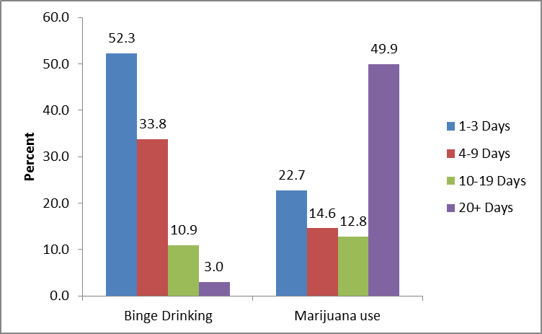
Number of days in past 30 days:
Binge drinking and marijuana use

Slide 22
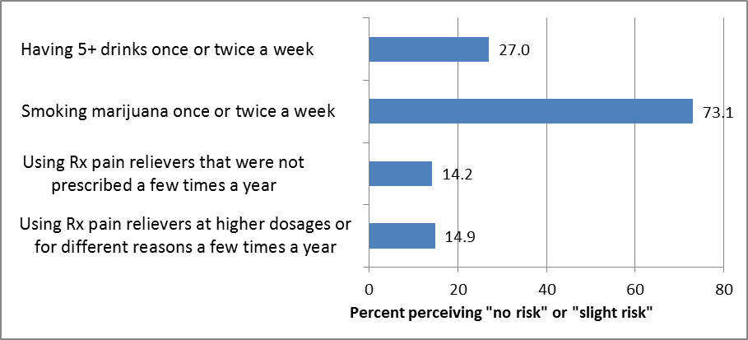
Low perceived risk of use: Binge drinking, marijuana use, and Rx pain reliever misuse

Slide 23
Top 3 most common comments received (2014 YAS)
Heroin and/or other hard drugs, addiction, or drug-related crime is a problem (either statewide or in community)
Marijuana is not harmful and/or should be legalized
Liked the survey / thanks for doing this

Slide 24
Contact Info and Links
Bob Flewelling
flewelling@pire.org
To access the survey (no data will be recorded), go to:
http://ncweb.pire.org/vtsurvey
and click on the word “survey” in the graphic at the top of page.
To access statewide report, go to:
http://www.pire.org/documents/Vermont_PFS_Eval/VT_PFS_YAS2014_Summary_Report.pdf

